Slide 1

Exercise 3 Neural Networks

Slide 2
General Information
Exam date: Wednesday, July 24, 13:00, Hörsaal 1

Slide 3
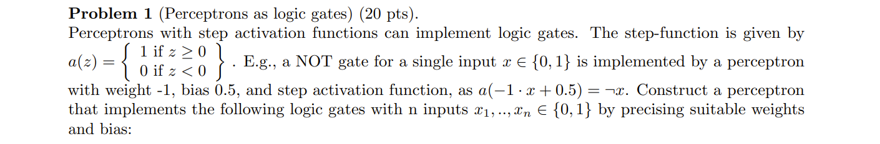

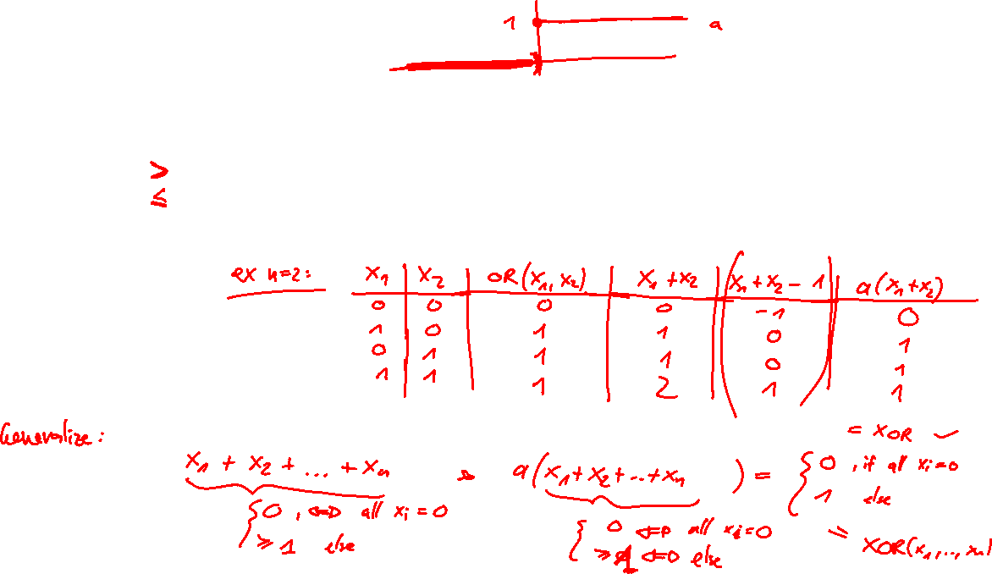
Problem 1

Slide 4
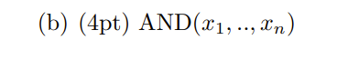
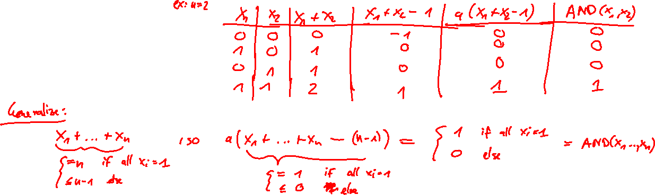
Problem 1

Slide 5
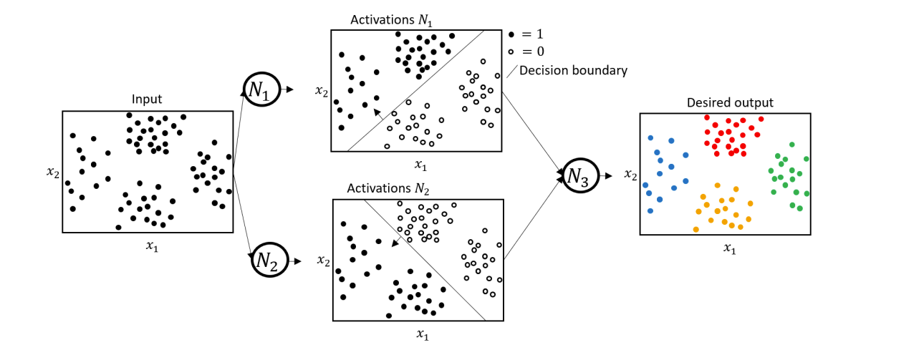
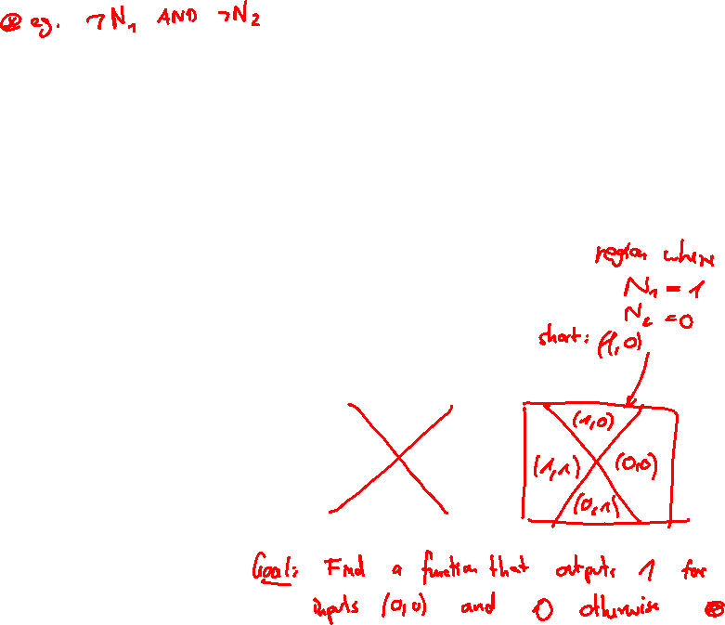
Problem 1

Slide 6
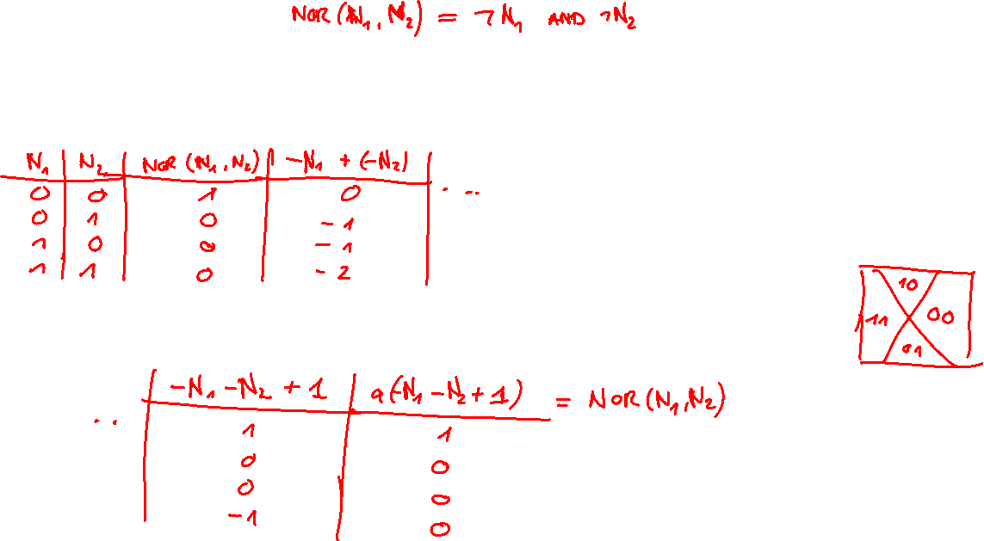
Problem 1

Slide 7
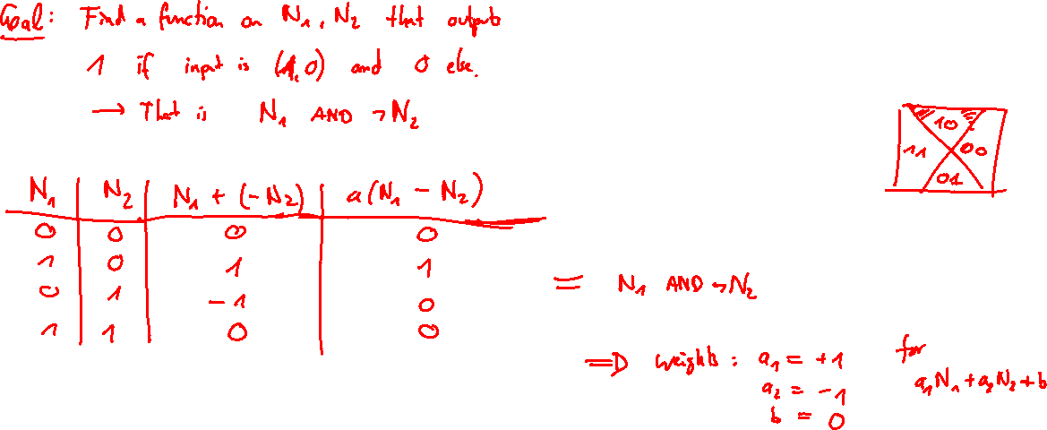
Problem 1

Slide 8
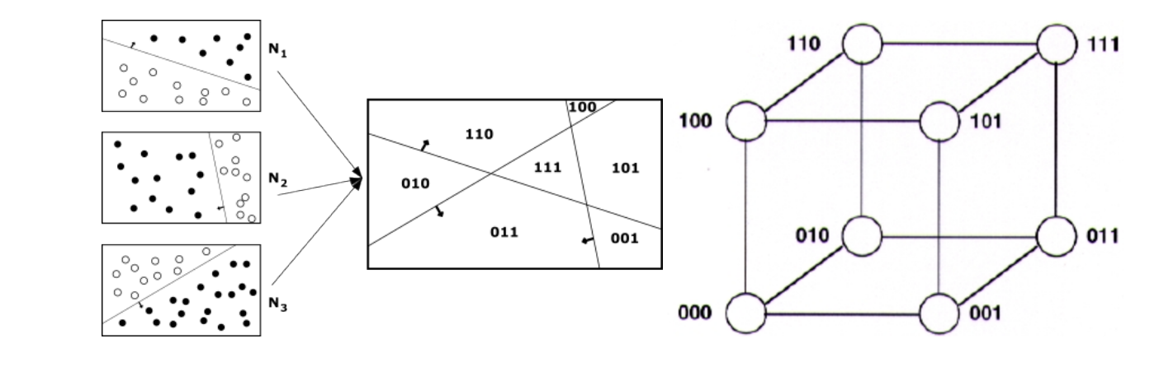
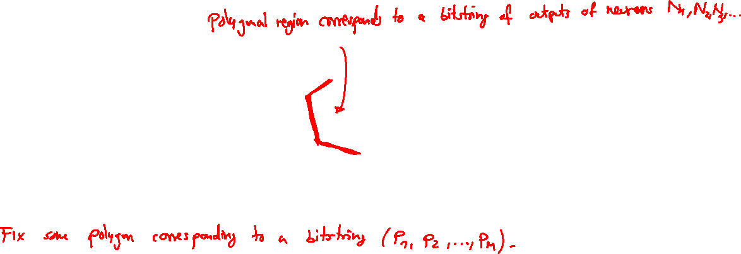
Problem 1

Slide 9
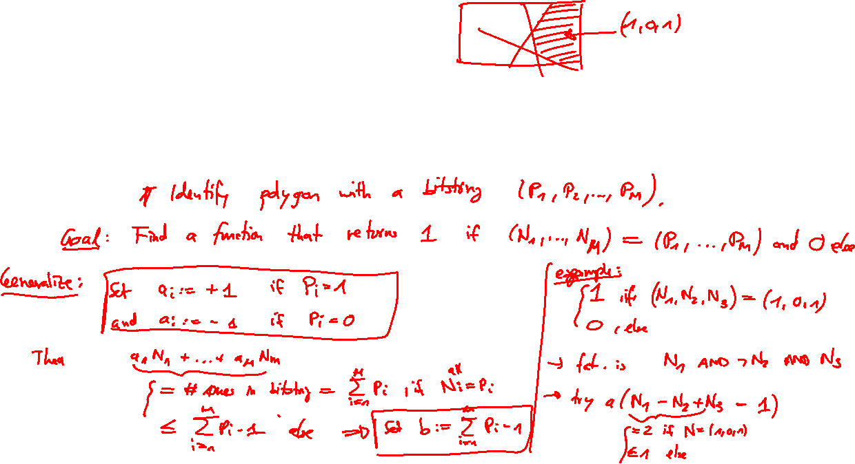
Problem 1

Slide 10
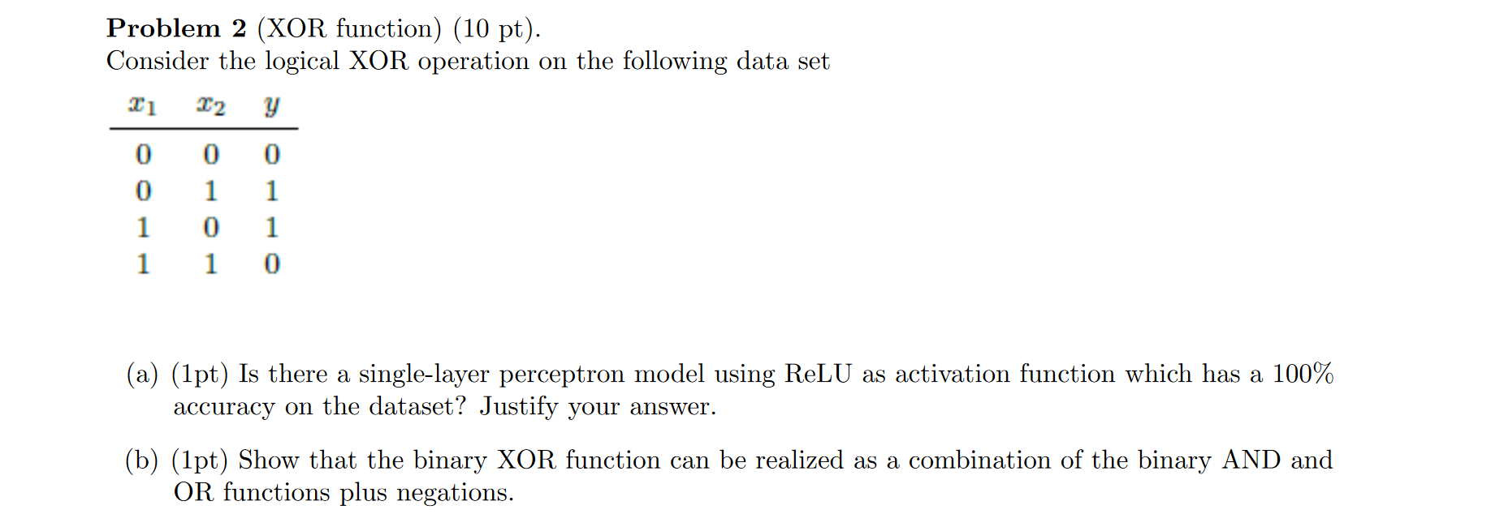
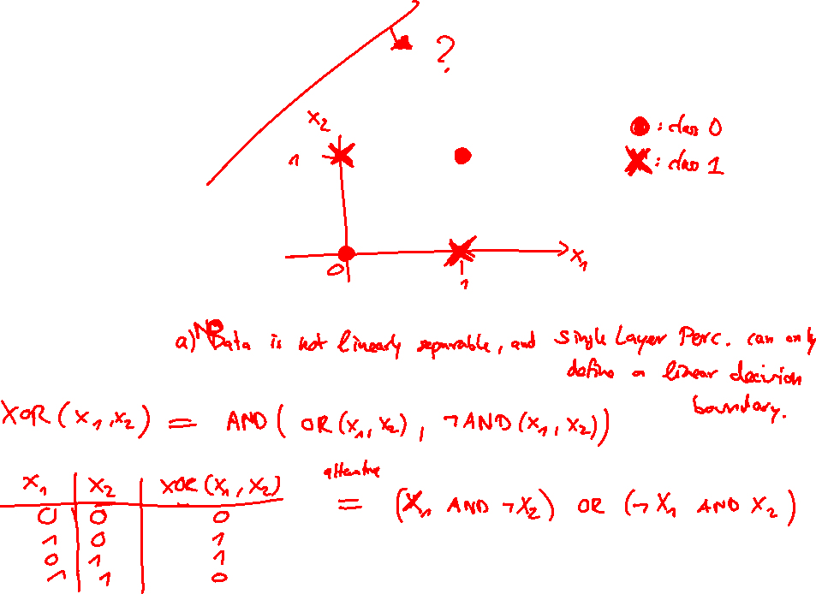
Problem 2

Slide 11
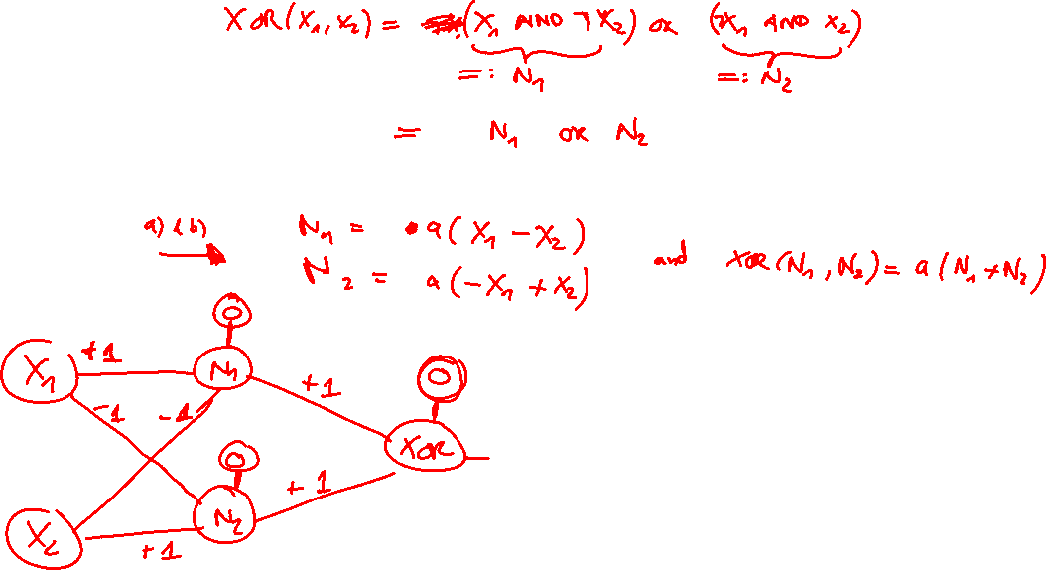
Problem 2

Slide 12














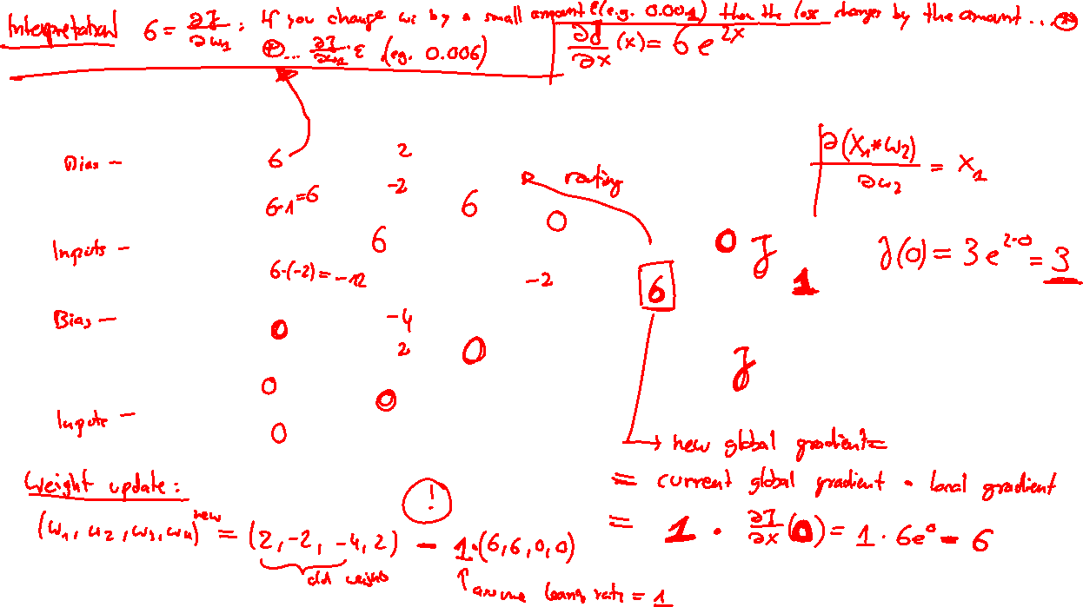

Backpropagation example

Slide 13
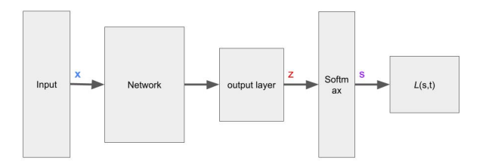
Gradient of the Softmax Loss
p
p

Slide 14
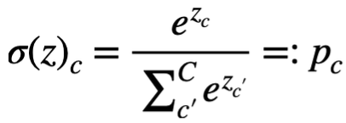
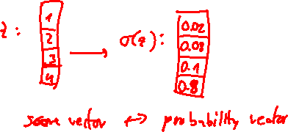
Gradient of the Softmax Loss
p
p

Slide 15
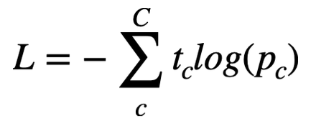
Gradient of the Softmax Loss
p
p

Slide 16
Gradient of the Softmax Loss
Question: What is the gradient dL/dz?
p
p

Slide 17
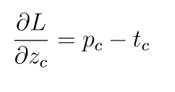
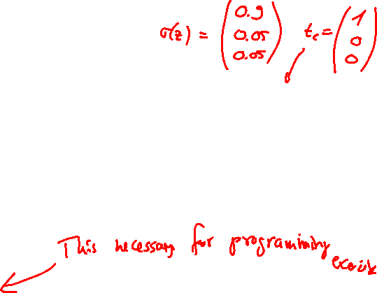
Gradient of the Softmax Loss
Question: What is the gradient dL/dz?
p
p

Slide 18
QUIZTIME

Slide 19
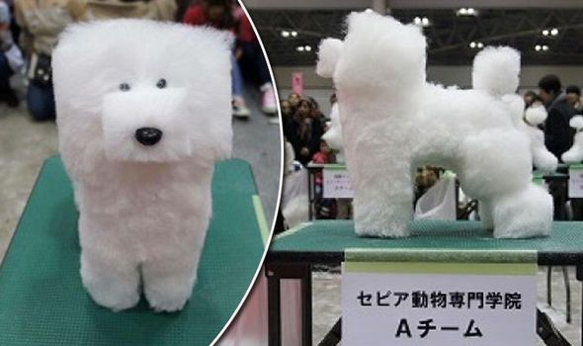







QUIZTIME

Slide 20
Quiztime
True or False?
A neural network with only two hidden layers and non-linear activation function is conceptually able to approximate arbitrary decision boundaries.

Slide 21

Quiztime
True or False?
A neural network with only two hidden layers and non-linear activation function is conceptually able to approximate arbitrary decision boundaries.

Slide 22
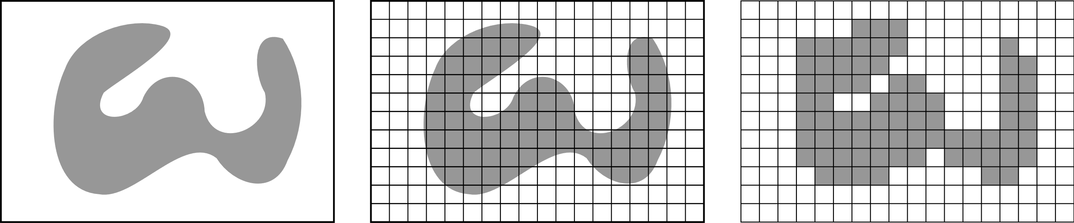
Quiztime
True or False?
A neural network with only two hidden layers and non-linear activation function is conceptually able to approximate arbitrary decision boundaries.

Slide 23
Quiztime
True or False?
A neural network with only two hidden layers and non-linear activation function is conceptually able to approximate arbitrary decision boundaries.

Slide 24
Quiztime
True or False?
A neural network with only two hidden layers and non-linear activation function is conceptually able to approximate arbitrary decision boundaries.
Universal Approximation Theorem
A neural network with at least one hidden layer, a sufficient number of neurons and a non-linear activation function can approximate any mathematical function

Slide 25
Thank you for your attention

